Slide 1
Python -Multithreading
Shah Ayub Quadri
aquadri@digital-lync.com

Slide 2

Index
Python Multithreading
Multithreading
• Multithreading Modules For Thread Implementation
• The Threading Module To Create Threads
• Synchronizing Threads

Slide 3
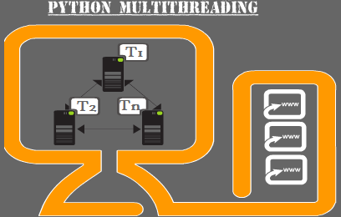
Multithreading
Multithreading is a core concept of software programming that almost all the high-level programming languages support.
The ability of a process to execute multiple threads parallelly is called multithreading.
Ideally, multithreading can significantly improve the performance of any program.
we’ll learn different methods to create threads and implement synchronization.
.

Slide 4

Multithreading
Python Multithreading Modules For Thread Implementation:
Python offers two modules to implement threads in programs
<thread> module.
<threading> module.
<thread> module is deprecated in Python 3 and renamed to <_thread> module for backward compatibility.
The key difference between the two modules is that the module <thread> implements a thread as a function. On the other hand, the module <threading> offers an object-oriented approach to enable thread creation.
How To Use The Thread Module To Create Threads:
The <thread> module to apply in your program, then use the following method.

Slide 5
Multithreading
This method is quite simple and efficient way to create threads. You can use it to run programs in both Linux and Windows.
This method starts a new thread and returns its identifier. It’ll invoke the function specified as the “function” parameter with the passed list of arguments. When the <function> returns, the thread would silently exit.
Here, args is a tuple of arguments; use an empty tuple to call <function> without any arguments. The optional <kwargs> argument specifies the dictionary of keyword arguments.
If the <function> terminates with an unhandled exception, a stack trace is printed and then the thread exits (It doesn’t affect other threads, they continue to run). Use the below code to learn more about threading.

Slide 6
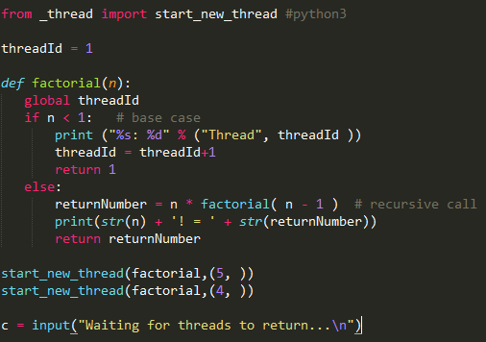
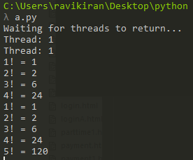
String Manipulation
Example:

Slide 7
String Manipulation
How To Use The Threading Module To Create Threads:
The <threading> module combines all the methods of the <thread> module and exposes few additional methods.
threading.activeCount(): It finds the total no. of active thread objects.
threading.currentThread(): You can use it to determine the number of thread objects in the caller’s thread control.
threading.enumerate(): It will give you a complete list of thread objects that are currently active.
<threading> module also presents the <Thread> class that you can try for implementing threads. It is an object-oriented variant of Python multithreading.

Slide 8
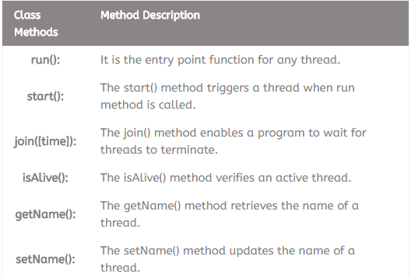
String Manipulation
The <Thread> class publishes the following methods

Slide 9
Multithreading
Steps To Implement Threads Using The Threading Module:
You may follow the below steps to implement a new thread using the <threading> module.
Construct a subclass from the <Thread> class.
Override the <__init__(self [,args])> method to supply arguments as per requirements.
Next, override the <run(self [,args])> method to code the business logic of the thread.
Once you define the new <Thread> subclass, you have to instantiate it to start a new thread. Then, invoke the <start()> method to initiate it.
It will eventually call the <run()> method to execute the business logic.

Slide 10
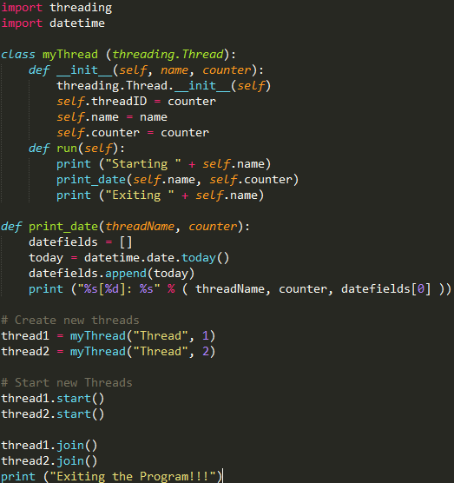
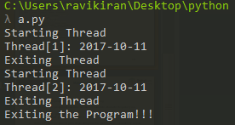
Multithreading
Create A Thread Class And Object To Print Current Date:

Slide 11
Multithreading
Python Multithreading – Synchronizing Threads:
The <threading> module has built in functionality to implement locking that allows you to synchronize threads. Locking is required to control access to shared resources to prevent corruption or missed data.
You can call Lock() method to apply locks, it returns the new lock object. Then, you can invoke the acquire(blocking) method of the lock object to enforce threads to run synchronously.
The optional blocking parameter specifies whether the thread waits to acquire the lock.
In case, blocking is set to zero, the thread returns immediately with a zero value if the lock can’t be acquired and with a 1 if the lock was acquired.
In case, blocking is set to 1, the thread blocks and wait for the lock to be released.
The release() method of the lock object is used to release the lock when it is no longer required.

Slide 12
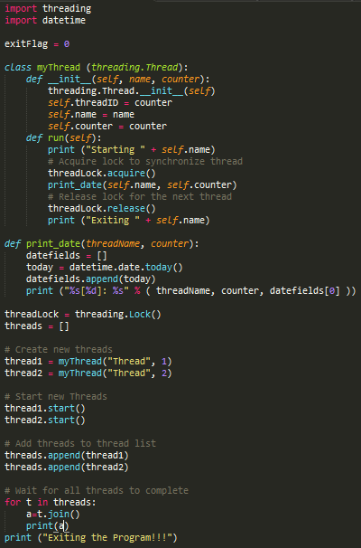
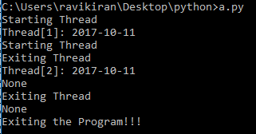
Multithreading
Python Multithreading Example For Locking:

